Slide 1
ROCKBUSTER
FINDINGS

Slide 2
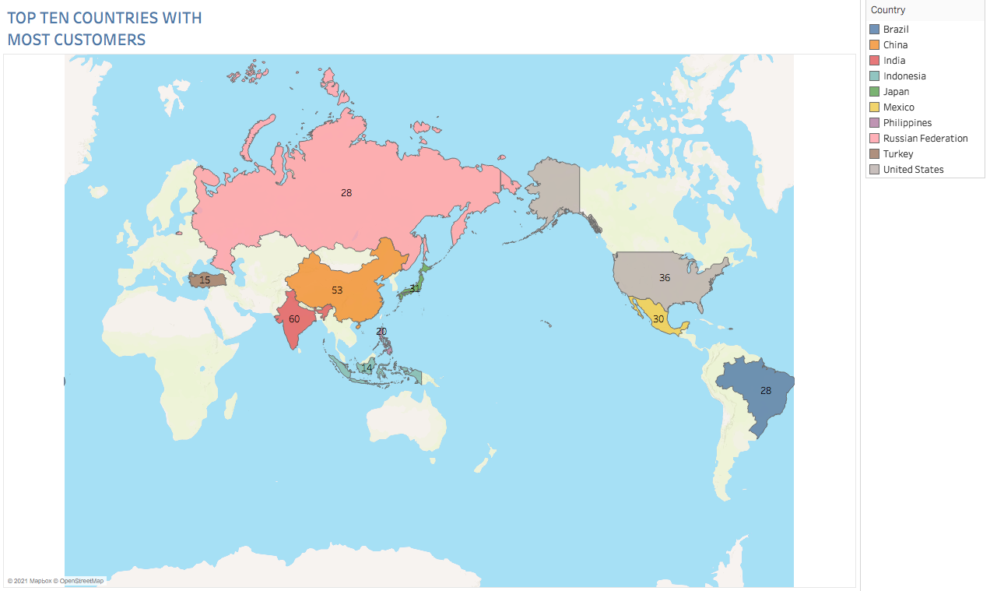
AS ROCKBUSTER CONTINUES THEIR JOURNEY WE CAN LOOK AT THOSE COUNTRIES WHERE IT IS THE MOST SUCCESFUL BY NUMBER OF CUSTOMERS

Slide 3
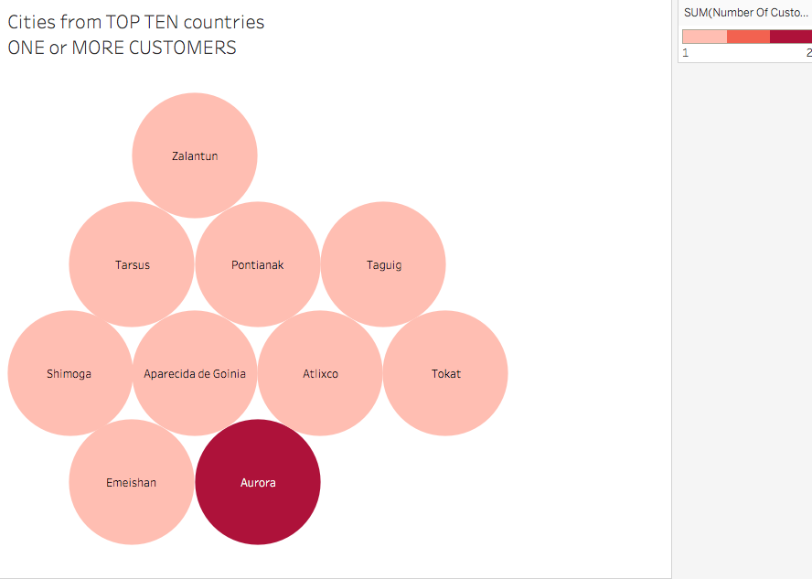
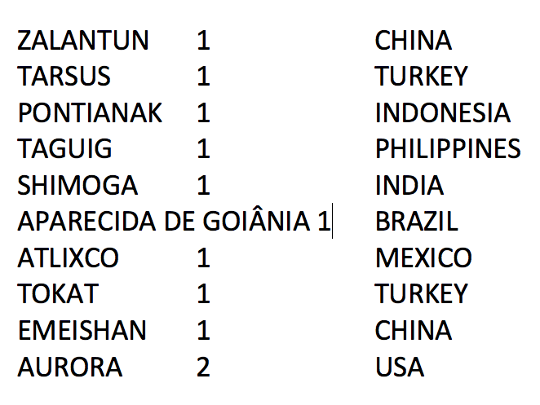
TOP TEN CITIES WITH MOST ROCKBUSTER CUSTOMERS

Slide 4
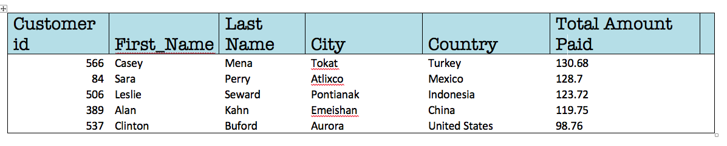
TOP FIVE ROCKBUSTER CUSTOMERS WORLDWIDE

